Slide 1
ServiceNow Case Study Presentation
Zac Boiskin
June 2021

Slide 2
Business Question and Goal
Does Customer Experience have an impact on growth of Aviato’s annual subscription revenue?
Hypothesis: Customer experience does have an impact on the of Aviato’s annual subscription revenue

Slide 3
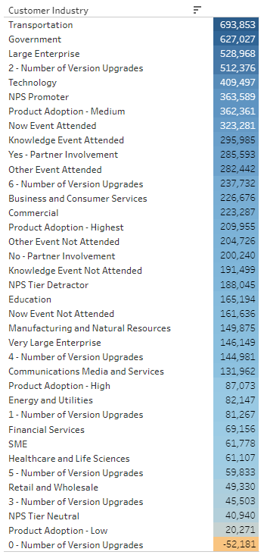
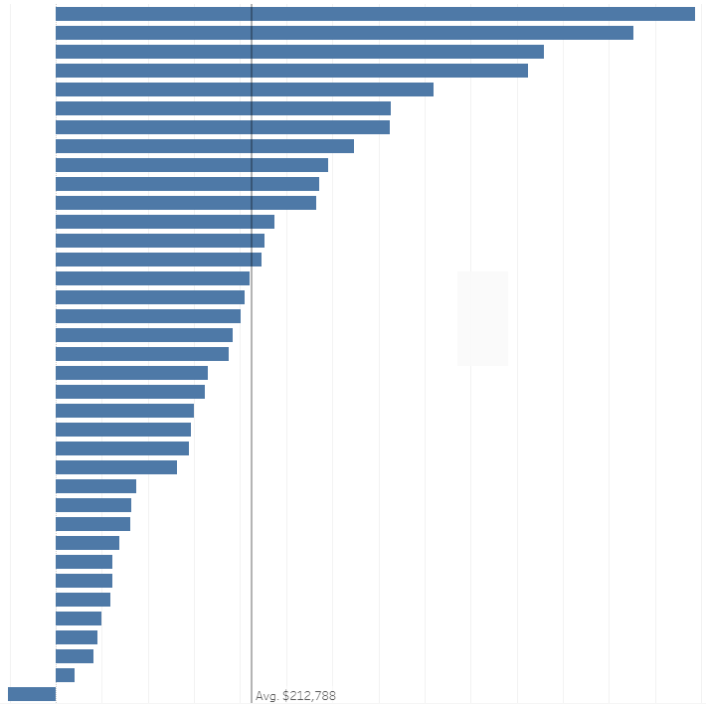
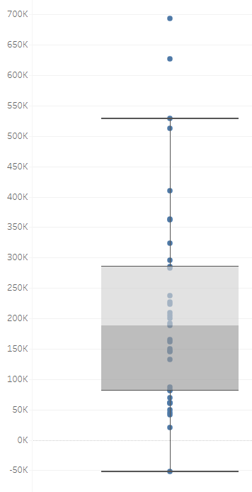
Customer Visuals

Slide 4
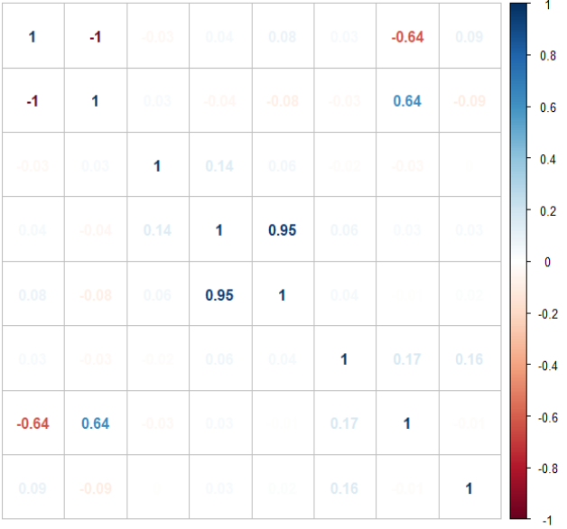
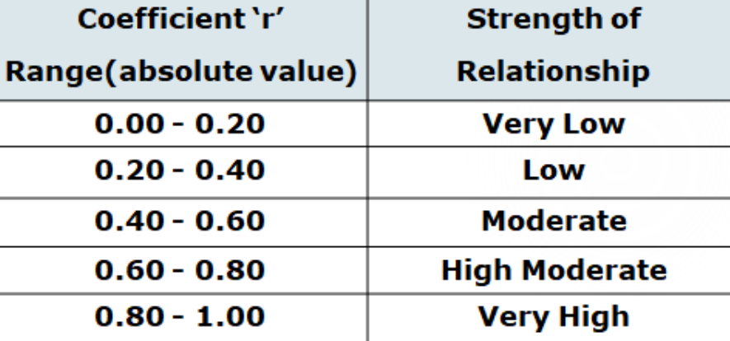
Correlation Matrix
A
B
C
D
E
F
G
H
*
A: Customer Start Qtr.
B: Years Active
C: Starting Yearly Subscription
D: Current Subscr. Rev.
E: Annual Change in Rev.
F: Avg. NPS Score
G: # of Upgrades
H: Adoption
A
B
C
D
E
0.04
F
0.04
G
H
* Source: https://sixsigmastats.com/scatter-plot-correlation-practical/

Slide 5
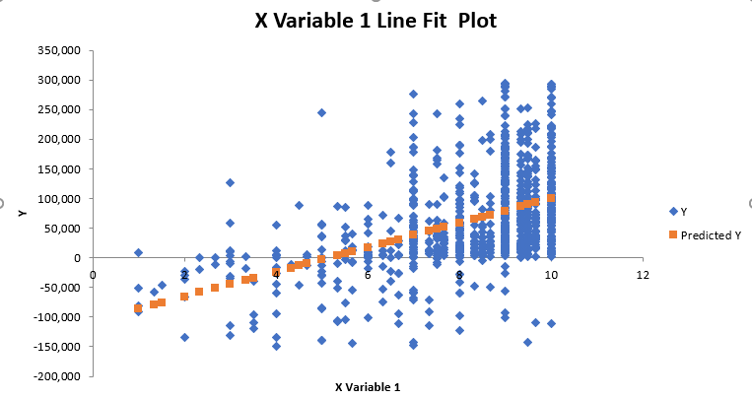
Regression: How much Revenue can NPS add?
Total Change In Rev: 10 NPS | $430,617,129.48
Total Change in Rev: Standard | $358,224,516.86
Difference: | $72,392,612.62
Annual Revenue Change $
Annual Rev. Change
Predicted Annual Rev. Change
Avg. NPS Score Per Customer

Slide 6

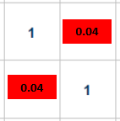
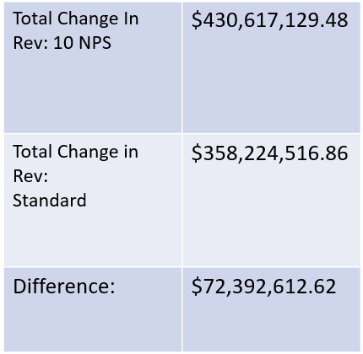
Summary and Recommendations
Few other variables that could possibly contribute more to overall revenue such as customer segment, customer industry and number of upgrades.
We were then able to see in the correlation matrix that NPS and revenue, while still a positive relationship, was very weak.
The regression analysis was able to give us a dollar amount to that weak, positive correlation by comparing how much change in revenue we saw in this data set, compared to what it could potentially be if in theory, all customers gave a perfect 10 NPS score.
Given this unlikelihood, my suggestion is for the company to consider targeting in factors such as customer segment and industry. While customer experience is important, I believe that there are better places to invest in in order to increase subscription revenue.

Slide 7
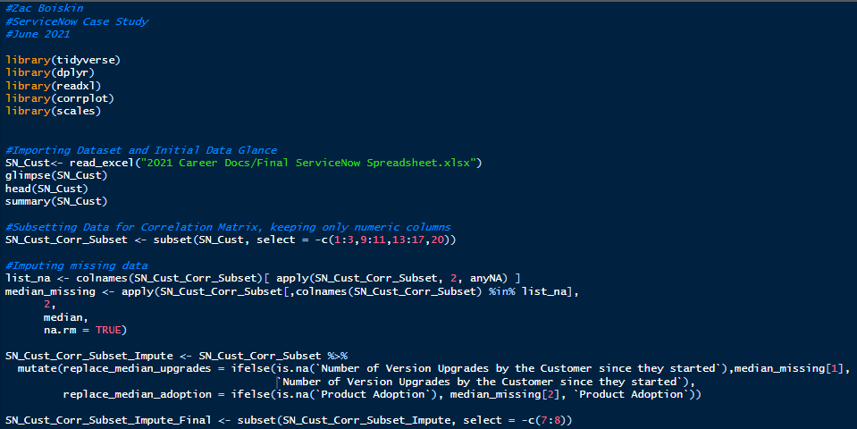
Appendix: R Code

Slide 8
Appendix: Excel Formulas for Calculated Fields Cont.
Annual Change in Revenue:
(Current Yearly Subscription – Starting Yearly Subscription) / Years Active = Annual Change in Revenue
Example: Starting Yearly Subscription = $423,414 Current Yearly Subscription = $779,082 Years Active = 2.5 ($779,082 - $423,414) / 2.5 = $142,267 Annual Change in Revenue

Slide 9
Appendix: Excel Formulas for Calculated Fields
Years Active Field:
Find and Replace “-Q1” with .00
Find and Replace “-Q2” with .25
Find and Replace “-Q3” with .50
Find and Replace “-Q4” with .75
Subtract numeric customer Start Quarter from Current Year (2019 Q3 = 20.5)
Example ’18-Q1 → 18.00
’19-Q3 → 20.5
20.5 - 18 = 2.5 years active

Slide 10
Appendix: Excel Formulas for Calculated Fields Cont.
Avg. NPS Score = Average of available NPS scores
Example:
2017 = 4 NPS
2018 = 7 NPS
2019 = 4 NPS
(4+7+4)/3 = 5 NPS
NPS Score Tier =
=IF(L2<=6.9, "Detractor", IF(L2<=8.9, "Neutral",IF(L2>=9, "Promoter")))
Product Adoption Tier =
=IF(S2<=0.25,"Low",IF(S2<=0.5,"Medium",IF(S2<=0.75,"High",IF(S2>=0.76,"Highest"))))
Example 2:
2017 = NA
2018 = 10 NPS
2019 = 8 NPS
(10+8)/2 = 9 NPS

Slide 11
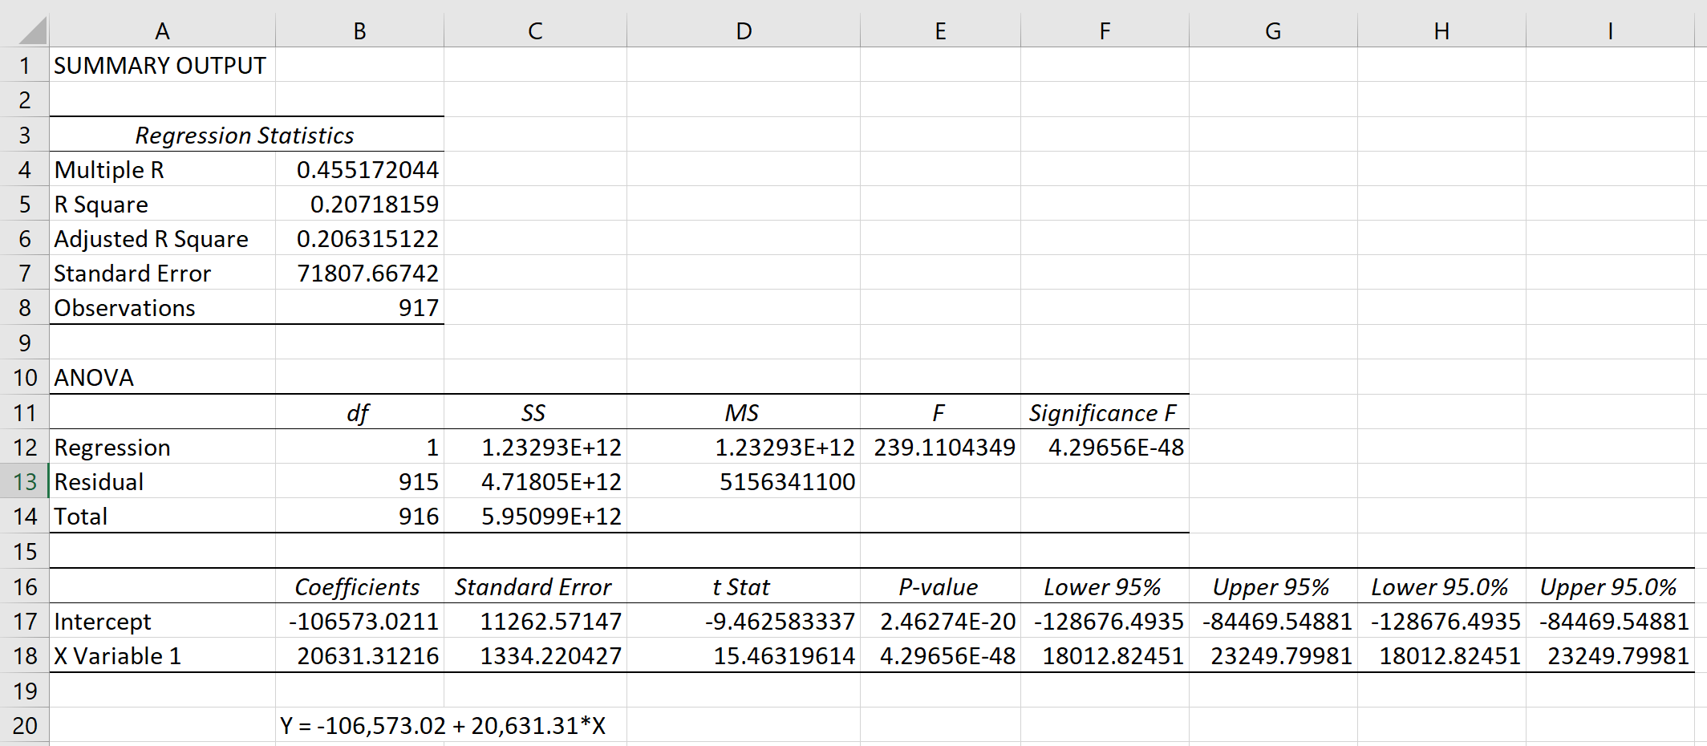
Appendix: Regression and Total Change in Rev vs Total Change in Rev with 10 NPS
Total Change in Rev with 10 NPS Score
=Best fit line equation, plug in 10 NPS
*sum(total years active)
=-106573.02+(20631*10)*2087.75
=$430,617,129.48
Total Change in Rev standard NPS Score
=Sum of Total Change in Rev. Per Customer
=$358,224,516.86
**Total Change in Rev. Per Customer
=Current Sub. Rev. - Starting Subscription on Rev.

